Slide 1
Diving
Down
the
Concurrency
Rabbit
Hole
Mike Acton
macton@insomniacgames.com

Slide 2
Expectations...
Start to unlearn "traditional" approach to concurrency issues
Assume some knowledge of concurrency approaches

Slide 3
Expectations...
Provide the rationale behind alternative approaches
Understanding why data/solutions are fundamentally different.

Slide 4
Expectations...
First in a series of concurrency optimization talks
Later
Later
Later
talks
talks talks
provide
provide focus a
examples
common patterns and solutions lot on lock/wait-free techniques

Slide 5
Expectations...
There are "thinking points" in here
Unanswered questions as exercises

Slide 6
Expectations...
I like to go off on interesting tangents.
But you may already know that.

Slide 7
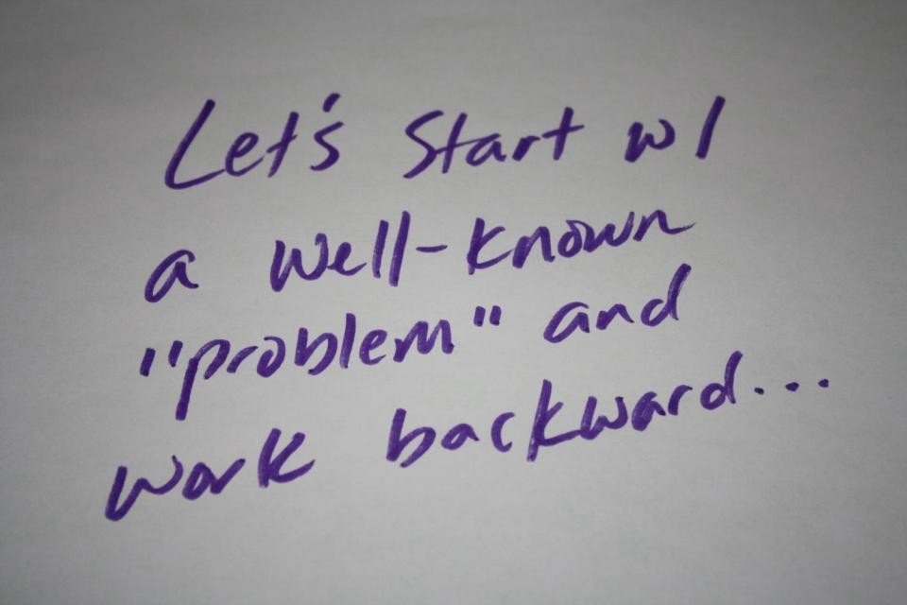

Slide 8
Reference Problem
But replacing locks wholesale by writing your own lock-free
code is not the answer. Lock-free code has two major drawbacks. First, it's not broadly useful for solving typical problems—lots of basic data structures, even doubly linked
lists, still have no known lock-free implementations.
Lock-Free Code: A False Sense of Security
Herb Sutter http://www.ddj.com/cpp/210600279

Slide 9
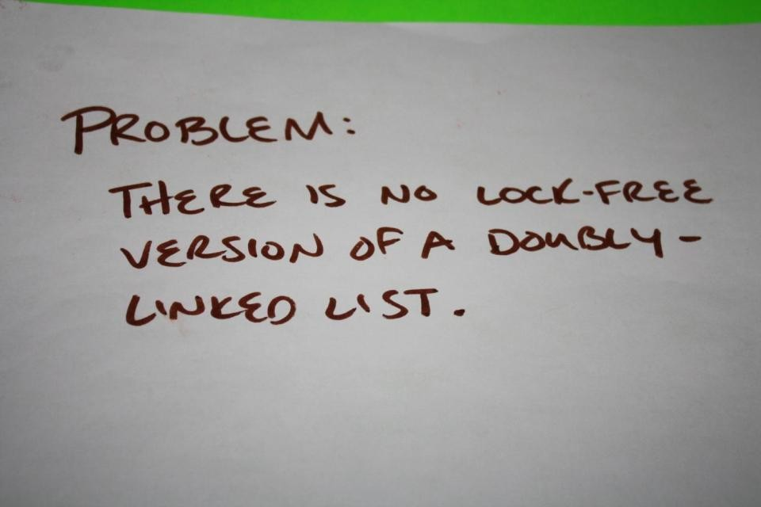

Slide 10
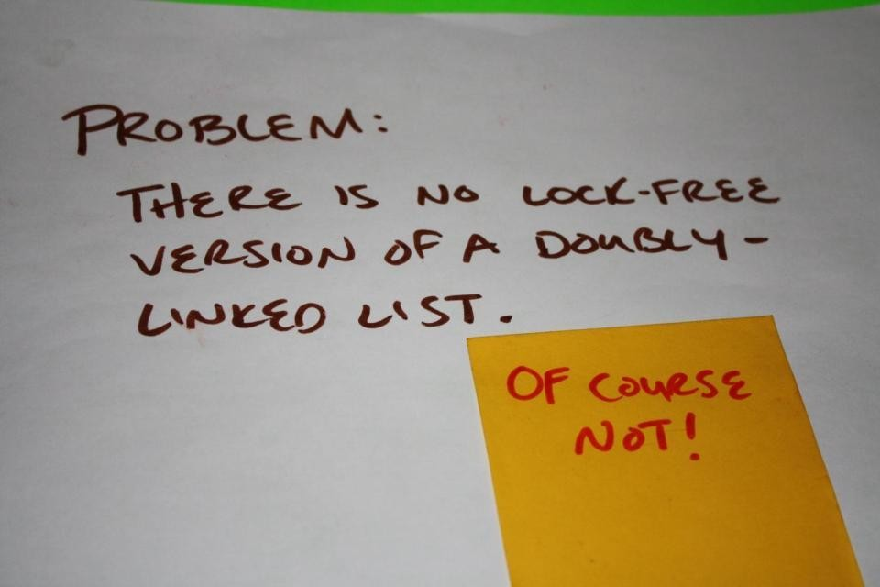

Slide 11
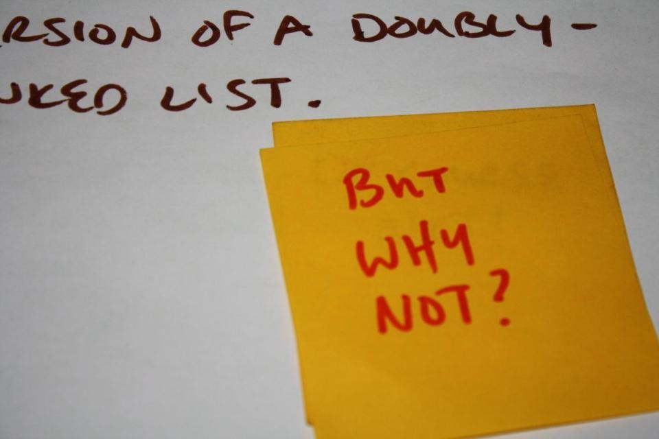

Slide 12
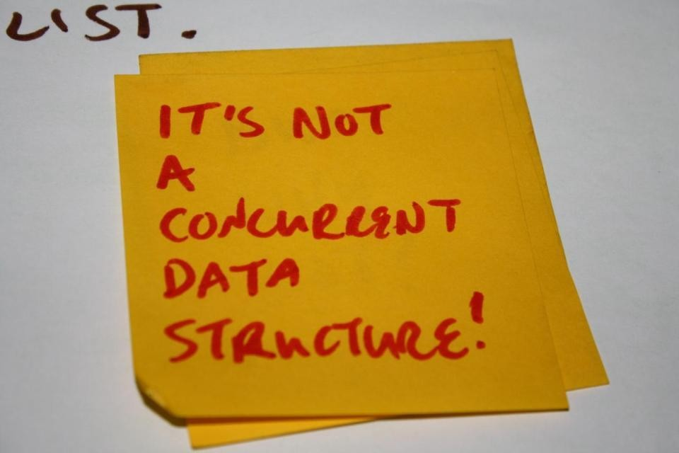

Slide 13
Reference Problem
But replacing locks wholesale by writing your own lock-free
code is not the answer. Lock-free code has two major drawbacks. First, it's not broadly useful for solving typical
problems—lots of basic data structures, even doubly
linked
lists, still have no known lock-free implementations.
Lock-Free Code: A False Sense of Security
Herb Sutter http://www.ddj.com/cpp/210600279
As an aside, I disagree with the point above.
that's a topic for a different day.
But

Slide 14
Reference Problem
The reference problem is just for context.
No lock-free doubly-linked list here.
Rather, background on why it's not an important problem.

Slide 15
Reference Problem
Should expect to understand:
A doubly-linked list will not meet concurrent system.
real constraints of a
i.e. It's not going to be the solution/data to a concurrent
problem.
If it's used, it's only in a local context.

Slide 16
Reference Problem
Should expect to learn:
Why and how concurrent data design is different.

Slide 17
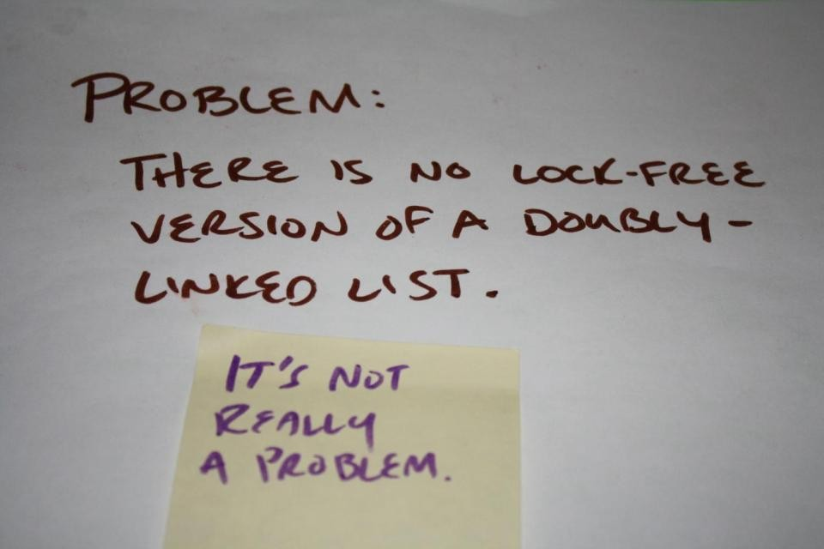

Slide 18
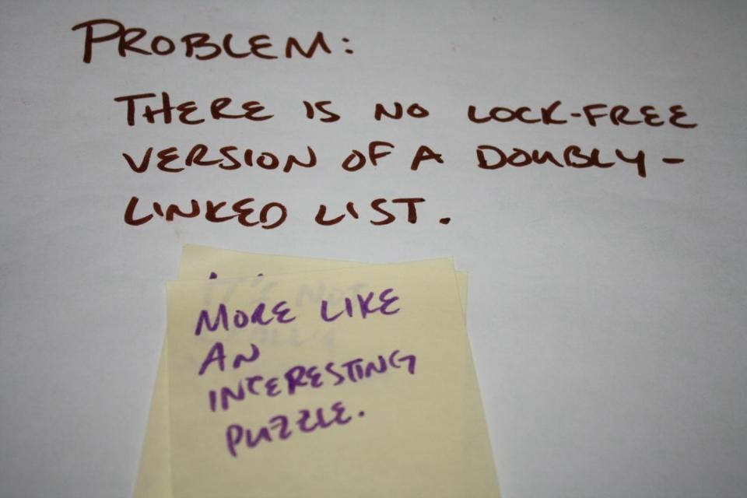

Slide 19
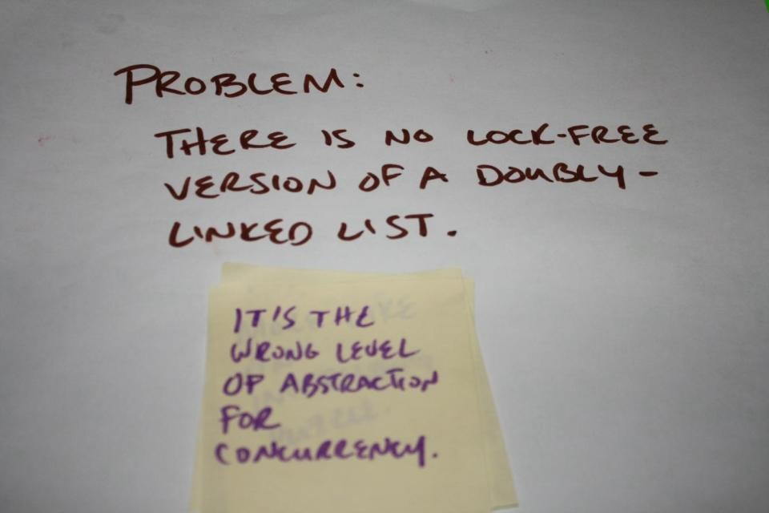

Slide 20
Why
would
data
structures
be
different
for
concurrent
designs?

Slide 21
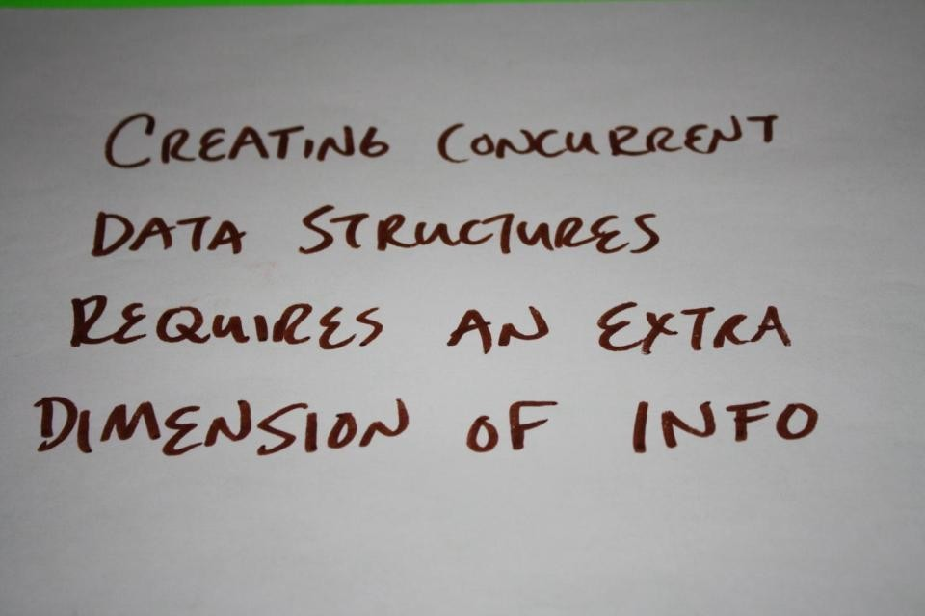

Slide 22


Slide 23
Why would data structures change?
Doubly-linked lists solve a particular set of problems
The concurrent "version" is a different problem
Data is designed around the problem(s) being solved.

Slide 24
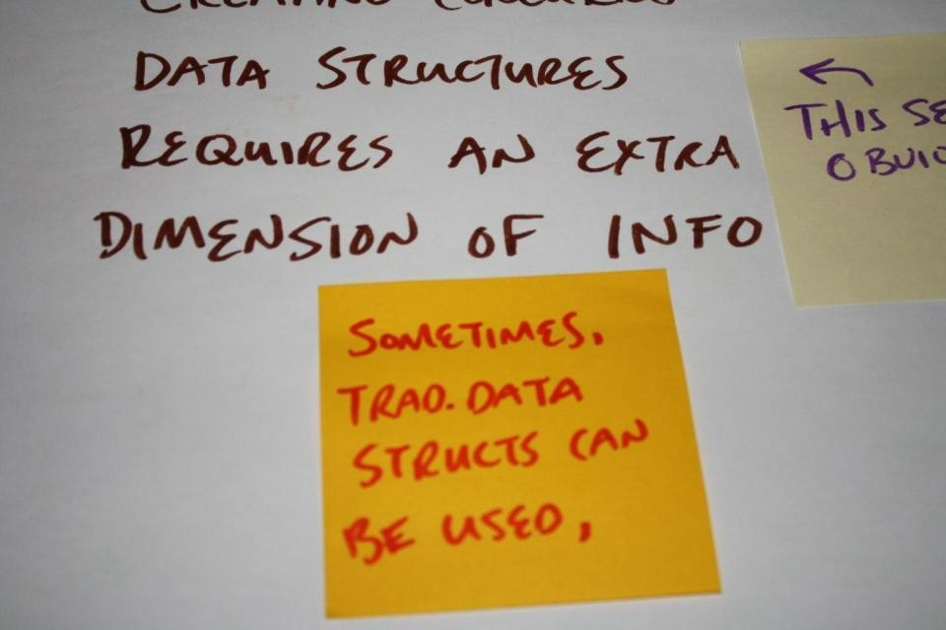

Slide 25


Slide 26


Slide 27
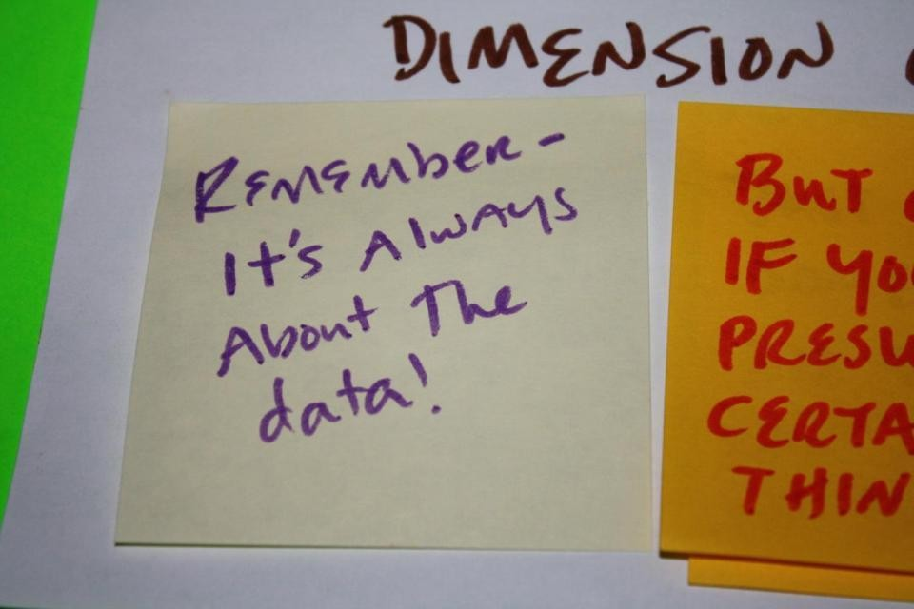

Slide 28
It's always about
the
data!
I will repeat this point a lot.
Why?
Because it's important!

Slide 29
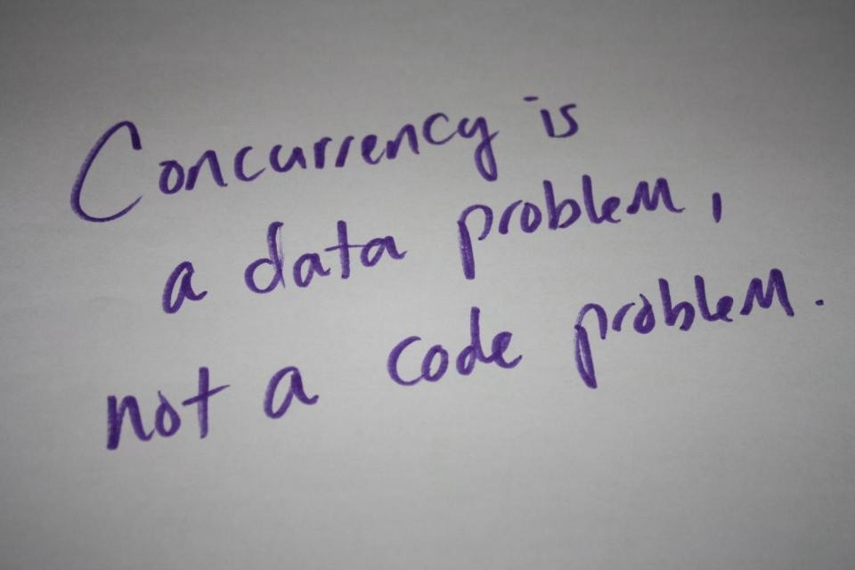

Slide 30
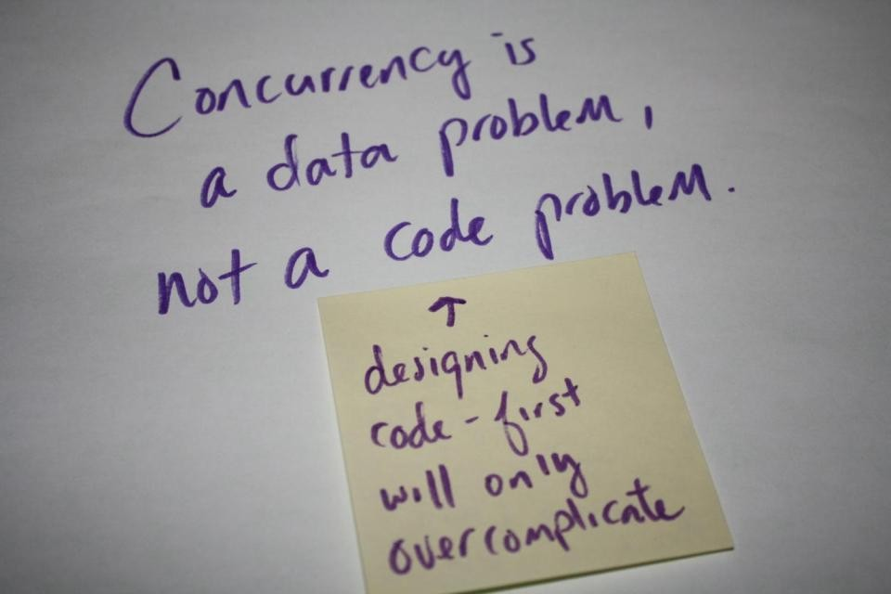

Slide 31
The Question
Is something like this the
problem?
best
data
fit
for
any
concurrency
struct
{
Node
Node*
Node* Packet*
next;
prev;
data;
};
The
(i.e.
data structure itself
local)
implies a different kind of problem

Slide 32
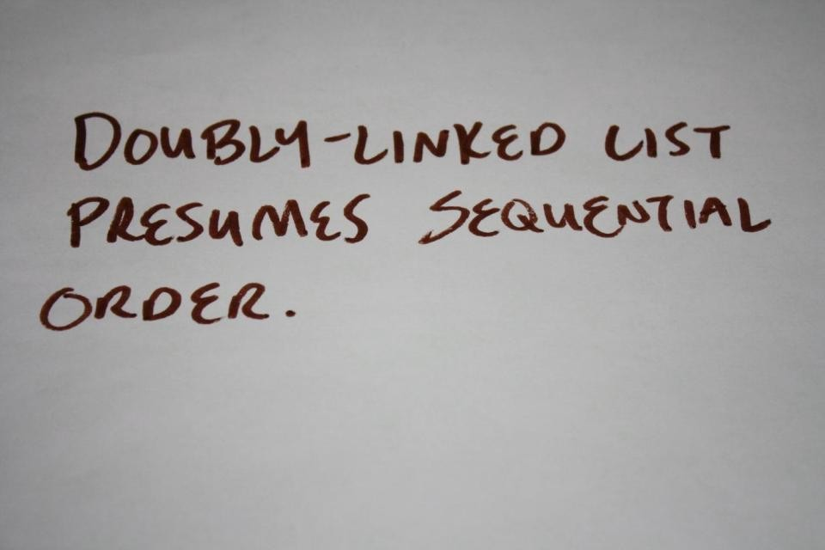

Slide 33
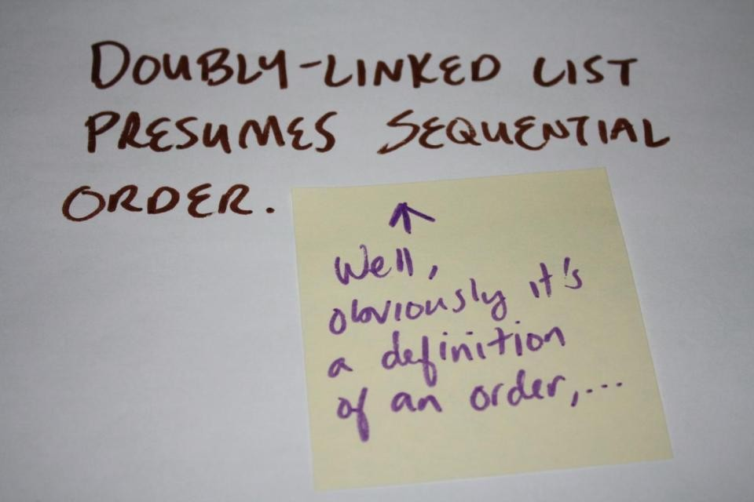

Slide 34
Defining Order
struct
{
Node
Node*
Node* Packet*
next;
prev;
data;
<--
<--
Defines
(That's
an
order
the
point.)
};

Slide 35
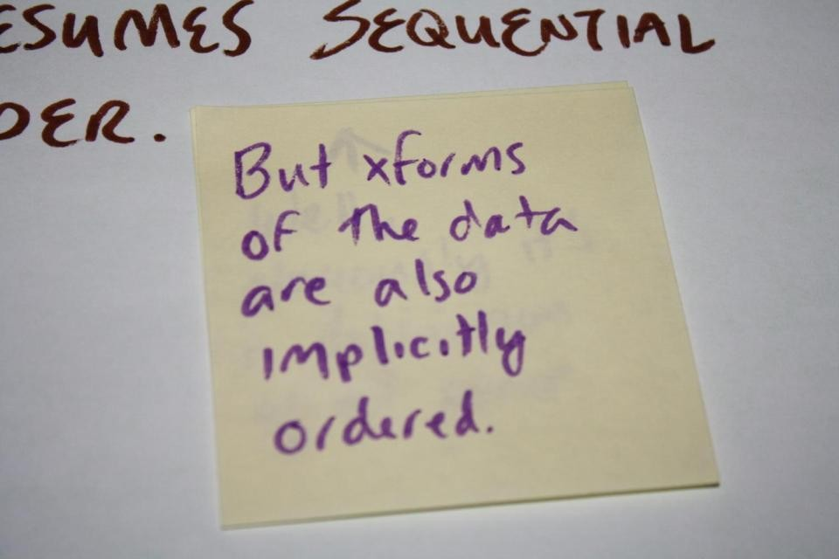

Slide 36
Transform Order
struct
{
Node
Node*
Node* Packet*
next;
prev;
data;
<--
<--
But
this
WHY
way
is
it
defined
in
1st
place?
};

Slide 37
Transform Order
struct
{
Node
Node*
Node* Packet*
next;
prev;
data;
<--
<--
But
this
WHY
way
is
it
defined
in
1st
place?
};
It's to make
certain operations easier.
And give those operations certain properties.
e.g. Insert, Delete

Slide 38
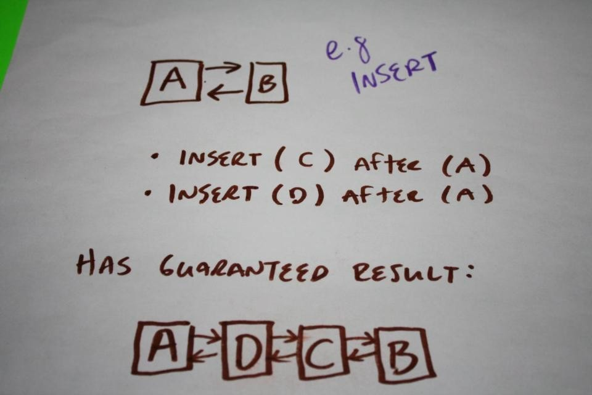

Slide 39
Transform Order
struct
{
Node
Node*
Node* Packet*
next;
prev;
data;
<--
<--
But
this
WHY
way
is
it
defined
in
1st
place?
};
e.g.
Insert
So that sequential insert
Have constant insert
instructions would:
time
Have a guaranteed (predictable) result
Could be inserted before or after given any node etc.

Slide 40
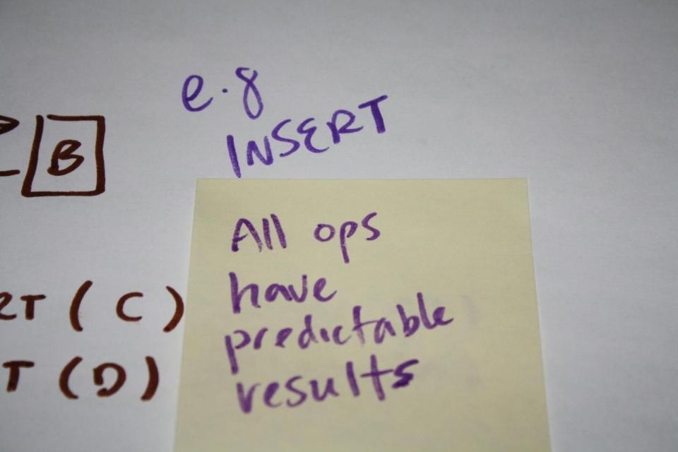

Slide 41
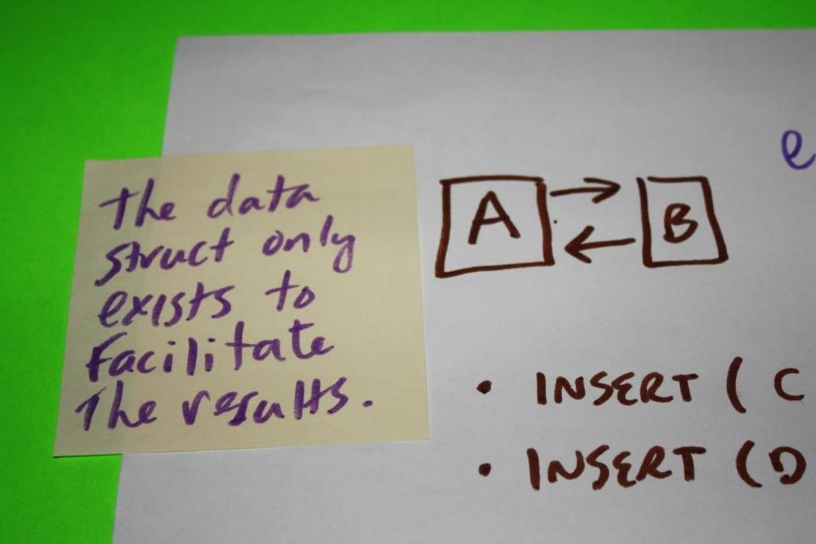

Slide 42
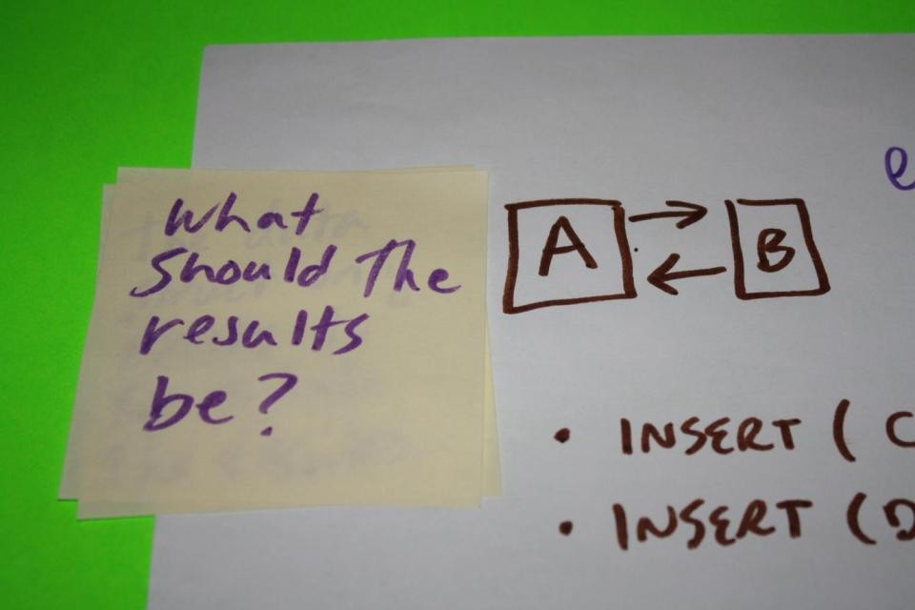

Slide 43
Need
to
define
what
the
transformations
must
do
before
you
the
can
define
what
data
is.

Slide 44
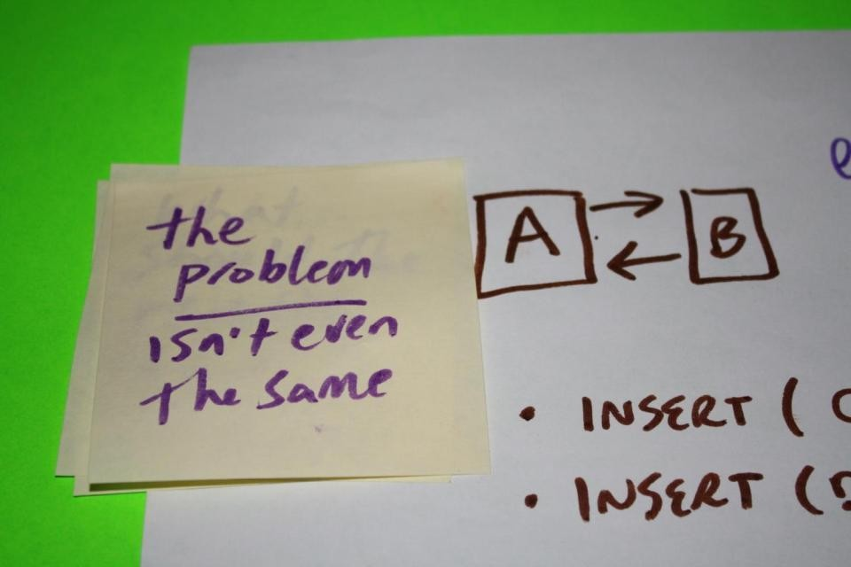

Slide 45
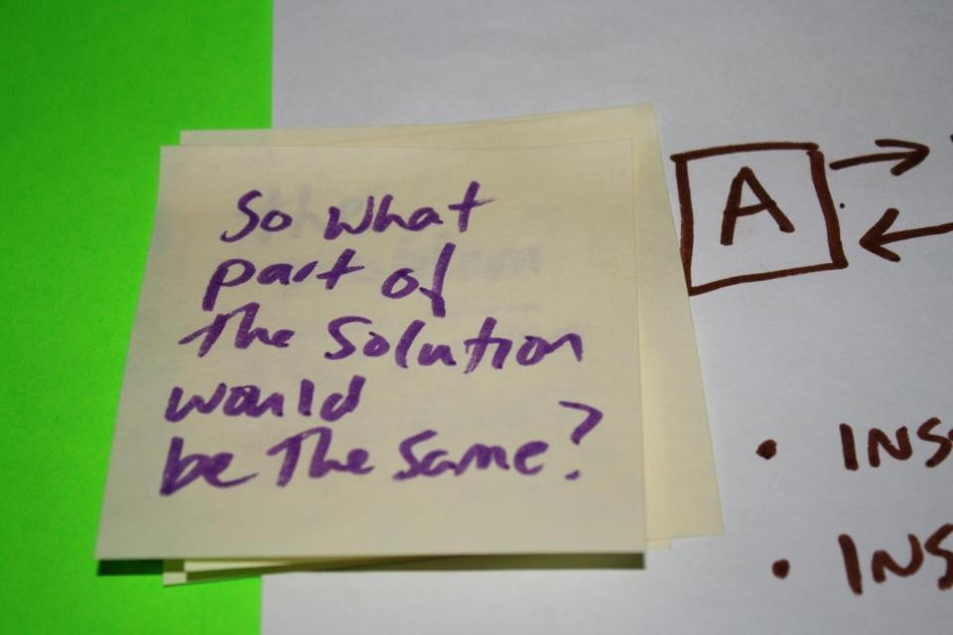

Slide 46
Operations
in a
concurrent
system
would
not
have
the
same
meaning.

Slide 47
The
properties
of
those
operations (constraints)
would
also
be
different.

Slide 48
Let's
look
at
the
"same"
problem
as
a
concurrent
operation...

Slide 49
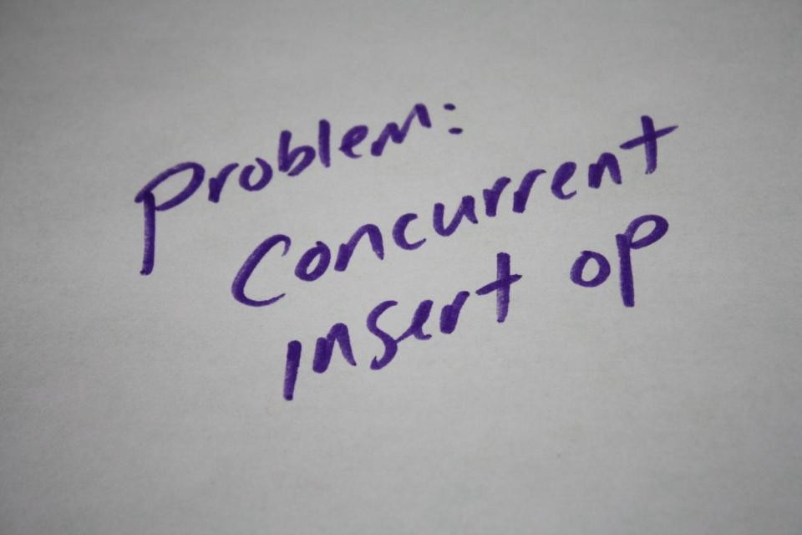

Slide 50
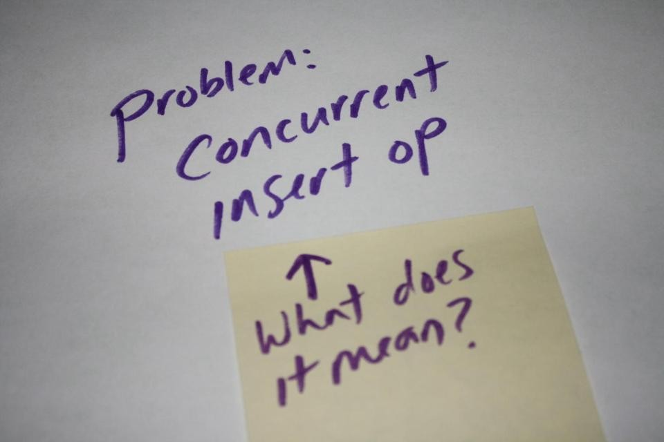

Slide 51
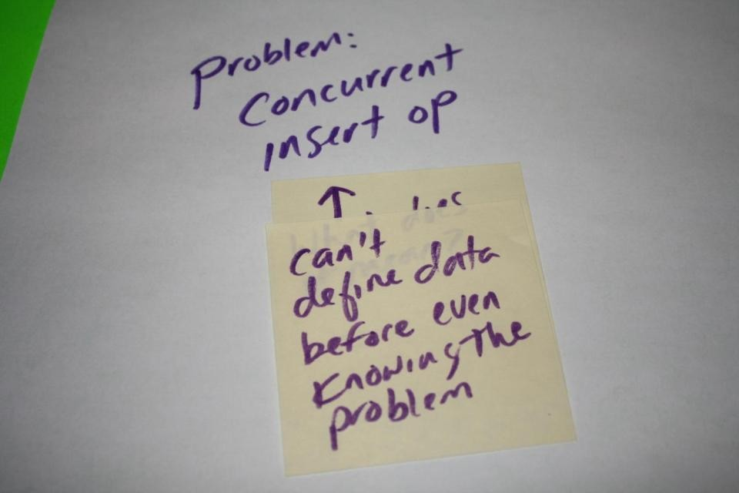

Slide 52
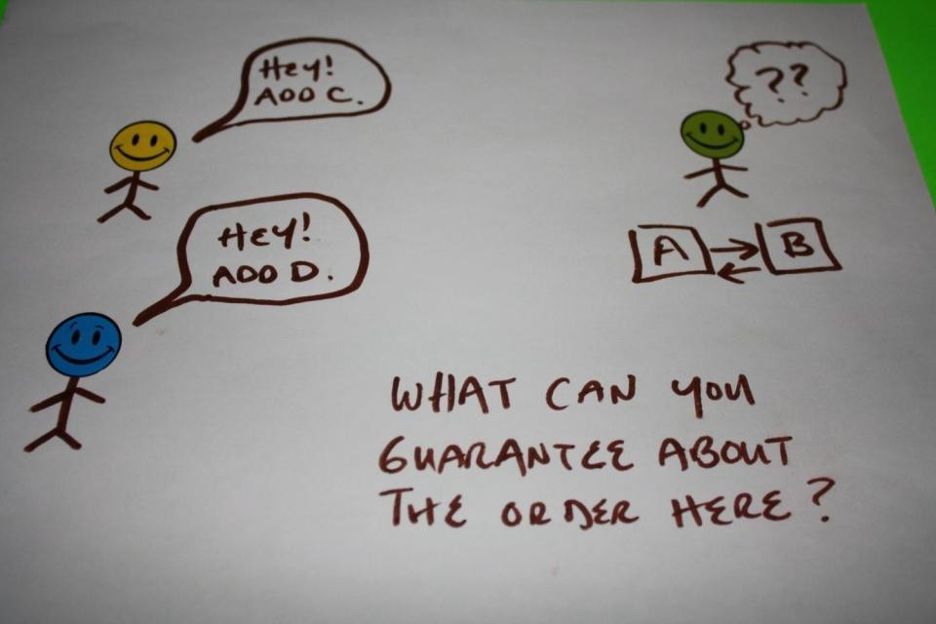

Slide 53


Slide 54


Slide 55
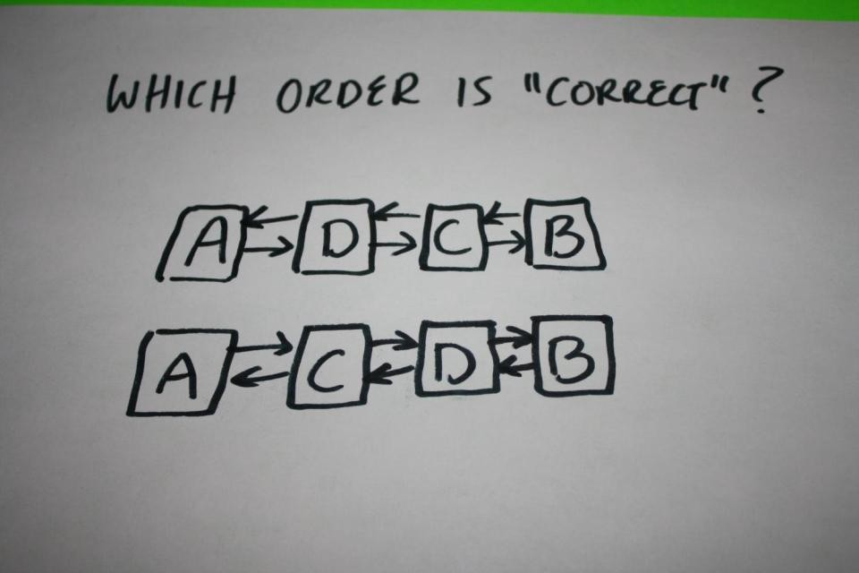

Slide 56
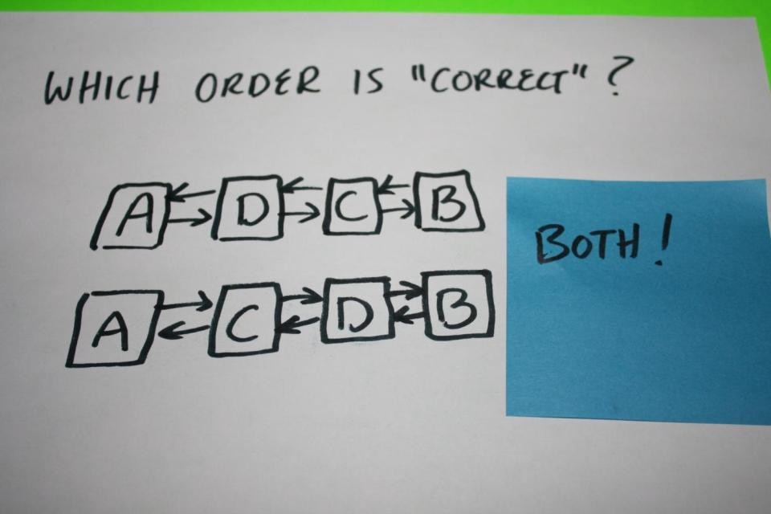

Slide 57
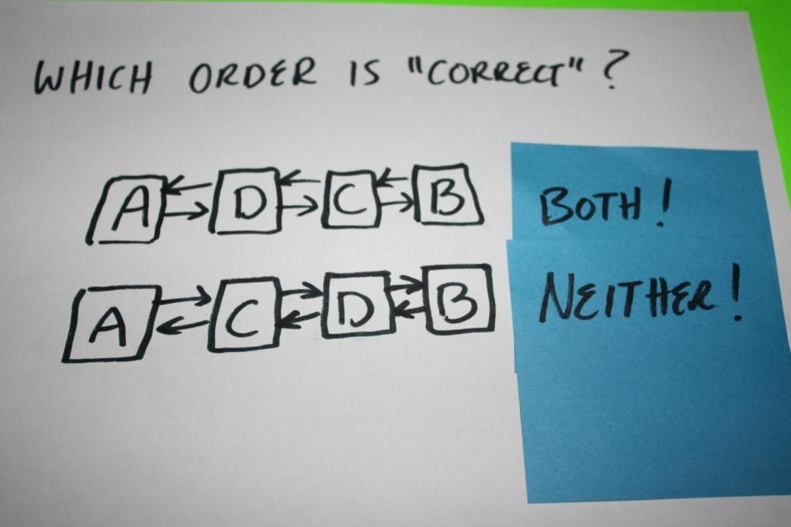

Slide 58
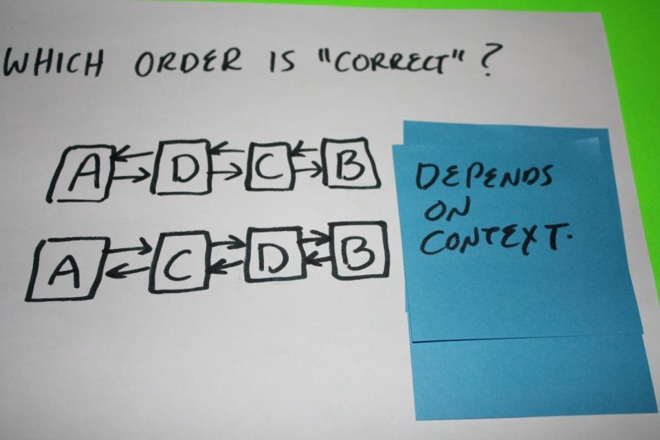

Slide 59
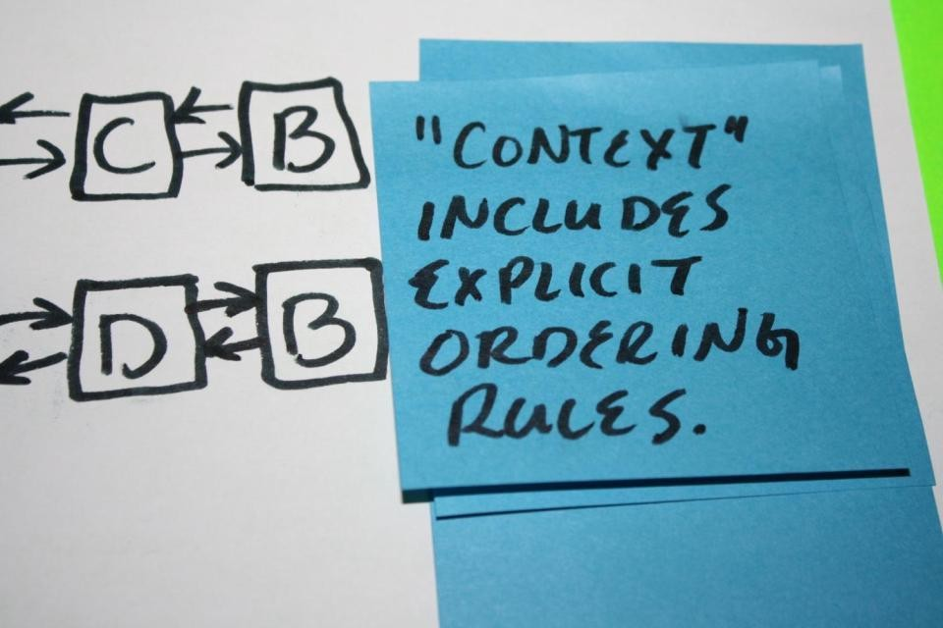

Slide 60
Concurrent
insert
operation
needs
explicit
ordering
rule.
(Extra
dimention
of
info.)

Slide 61
The
data
structure
would
be
different
to
accommodate
ordering
rule.

Slide 62
Is
that
all
the
extra
information
needed?
Hint:
No.

Slide 63
So how
would we
solve
the
concurrent
problem?

Slide 64


Slide 65


Slide 66
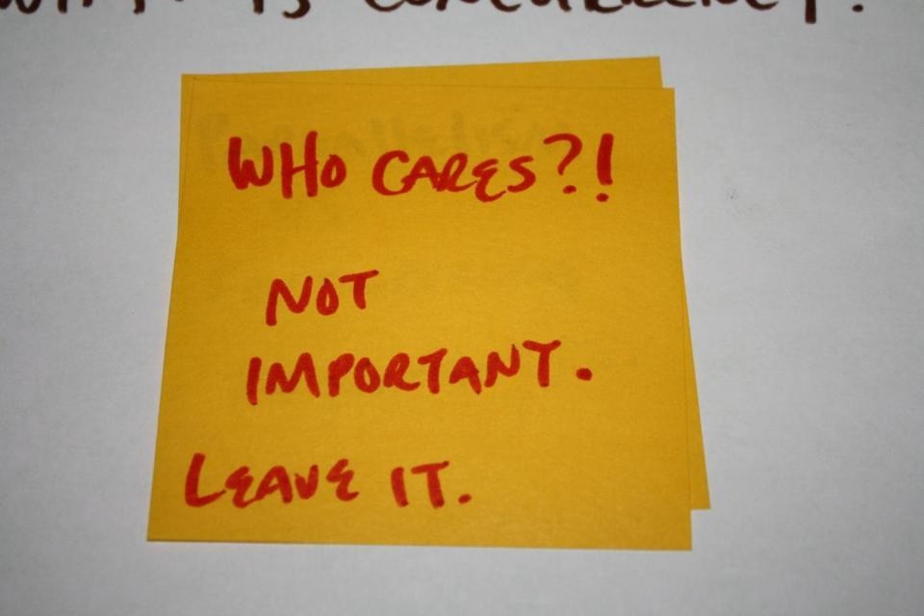

Slide 67


Slide 68
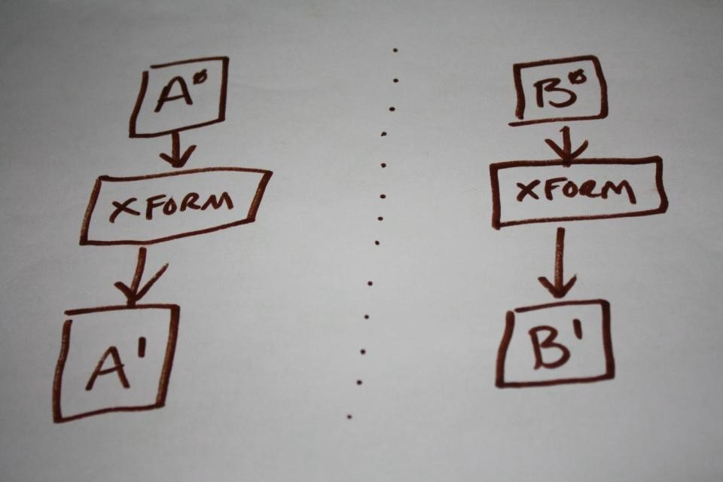

Slide 69
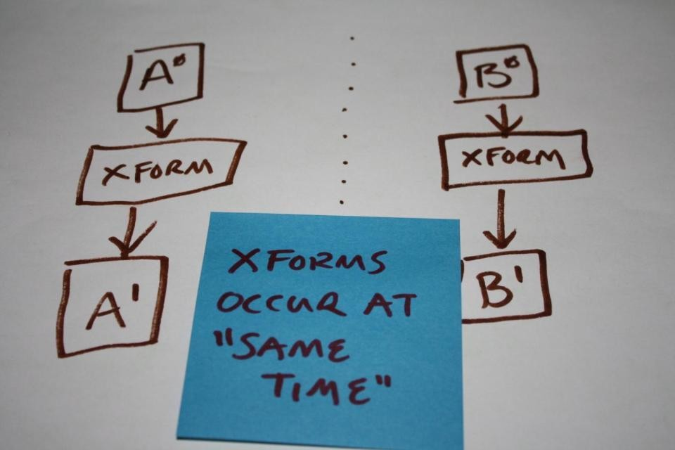

Slide 70
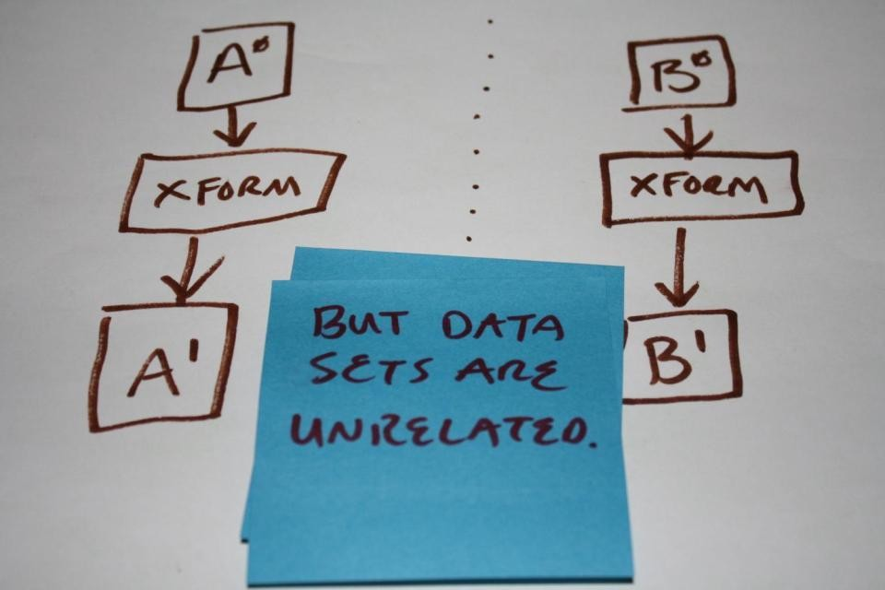

Slide 71
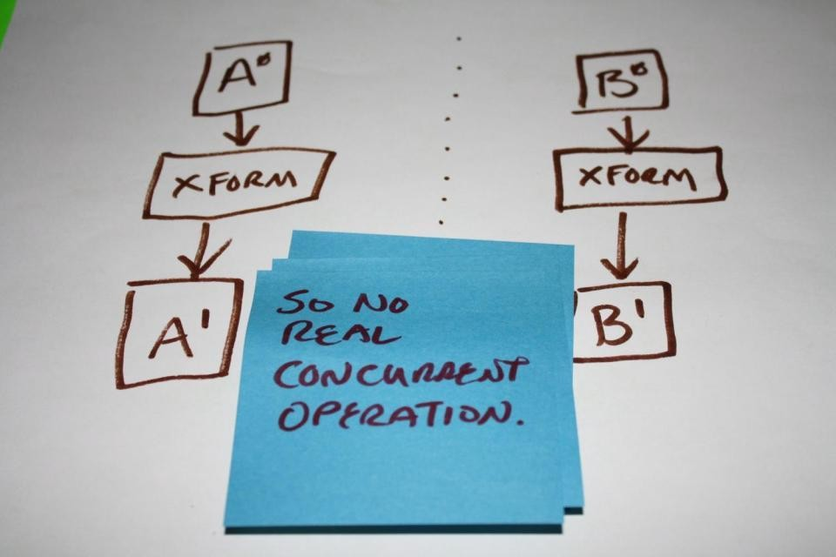

Slide 72
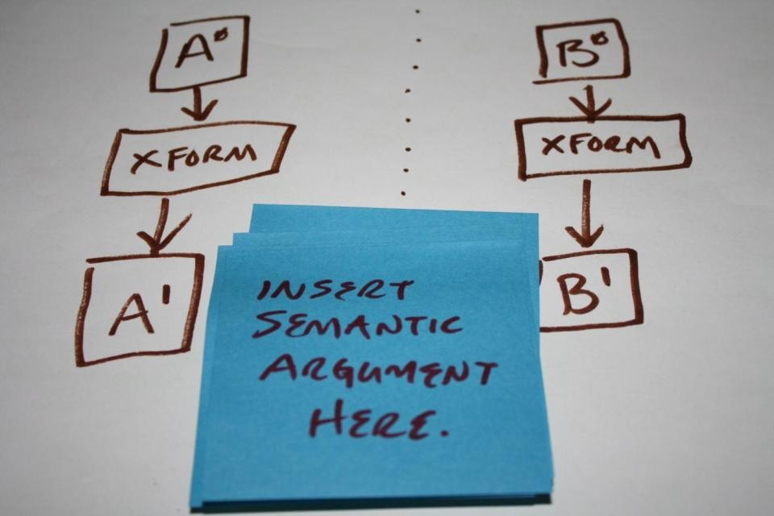

Slide 73
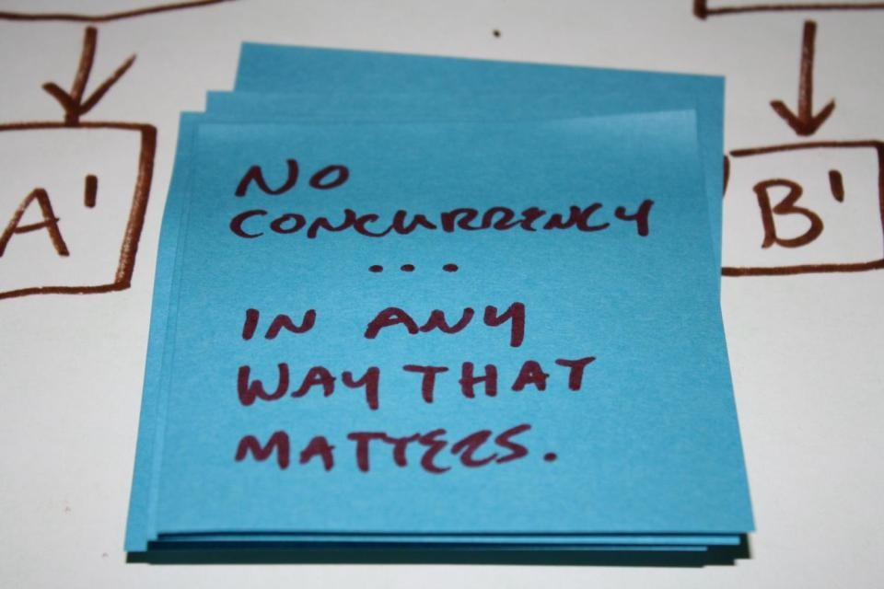

Slide 74
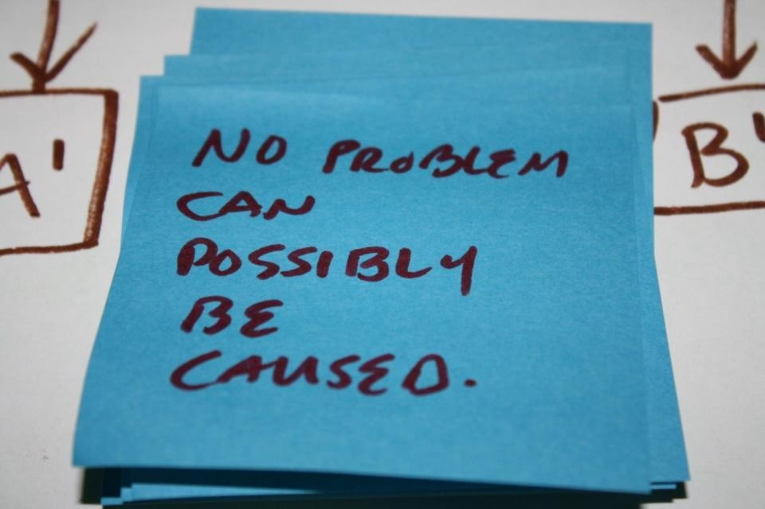

Slide 75
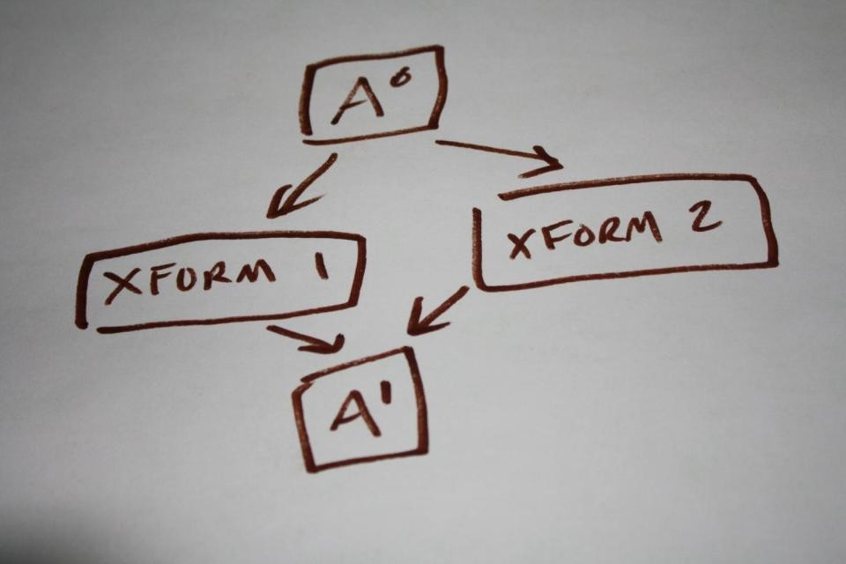

Slide 76
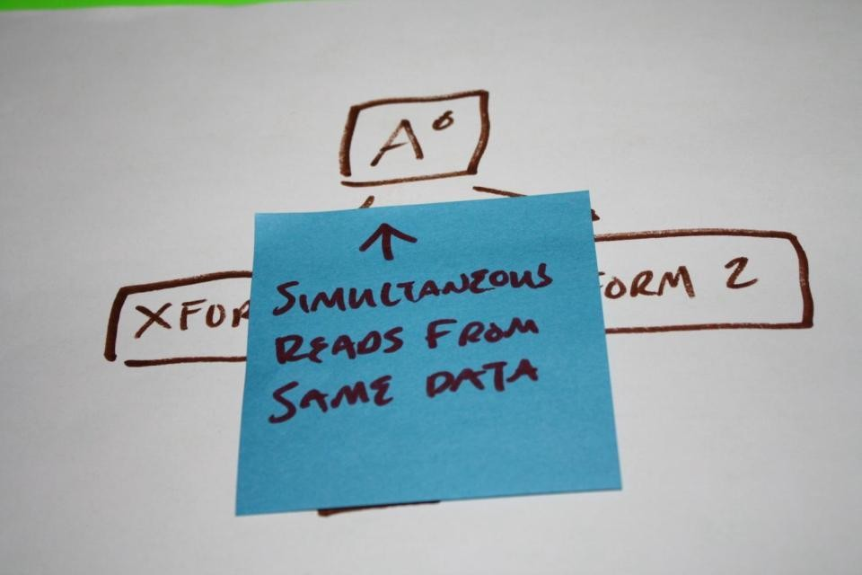

Slide 77
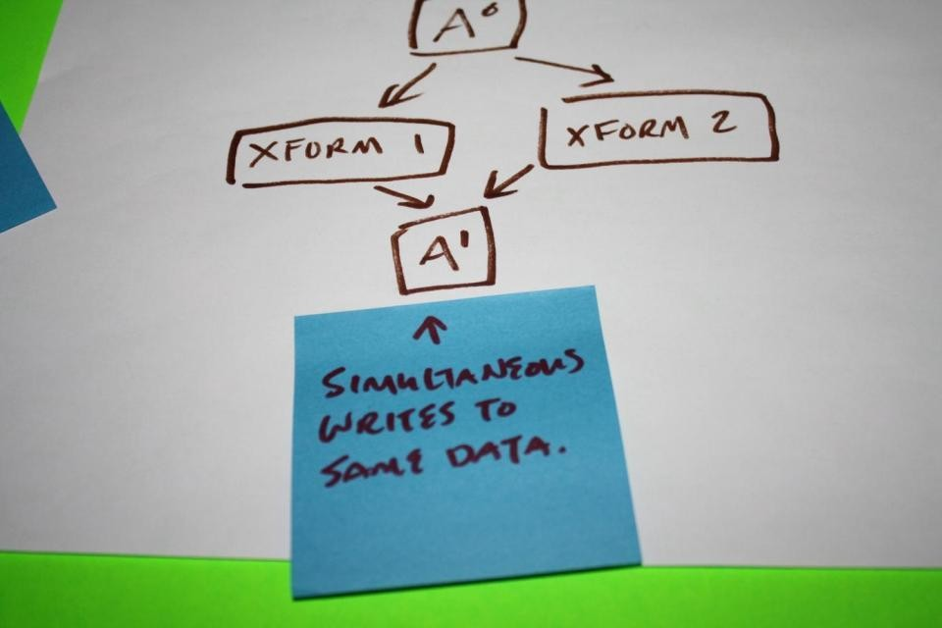

Slide 78
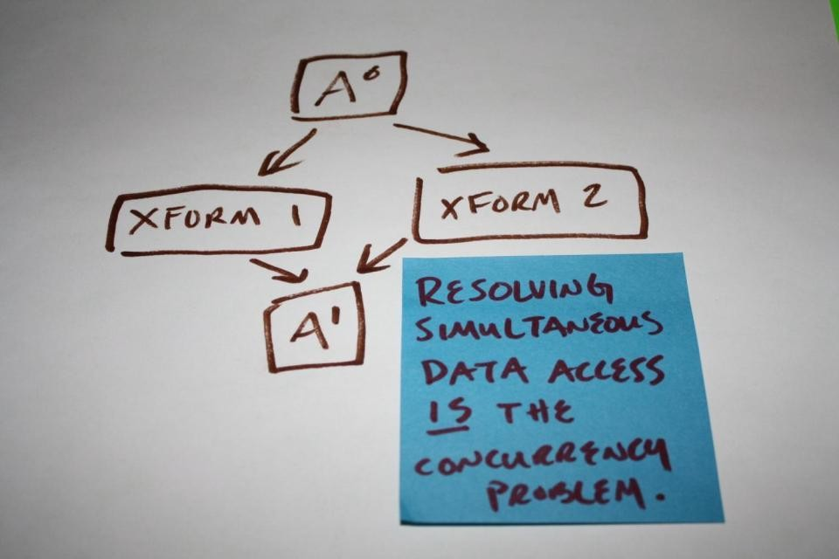

Slide 79
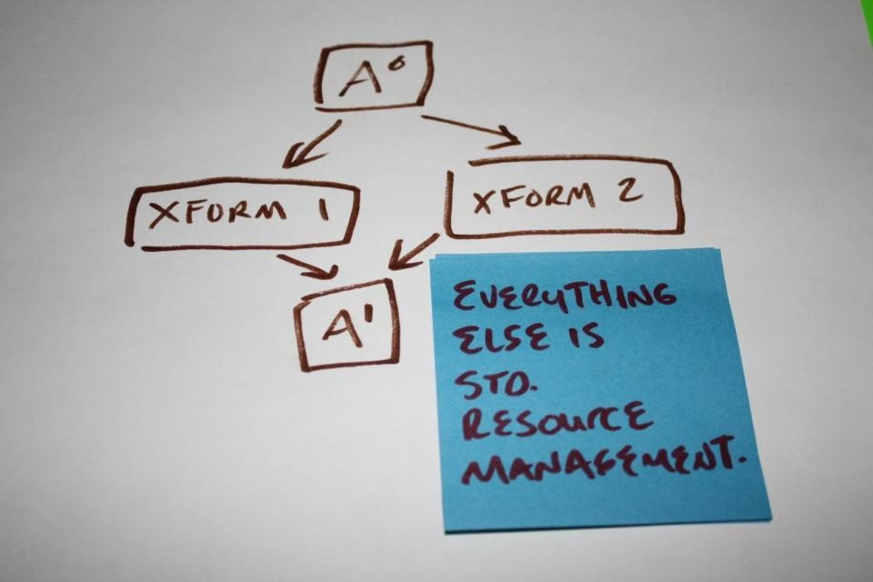

Slide 80
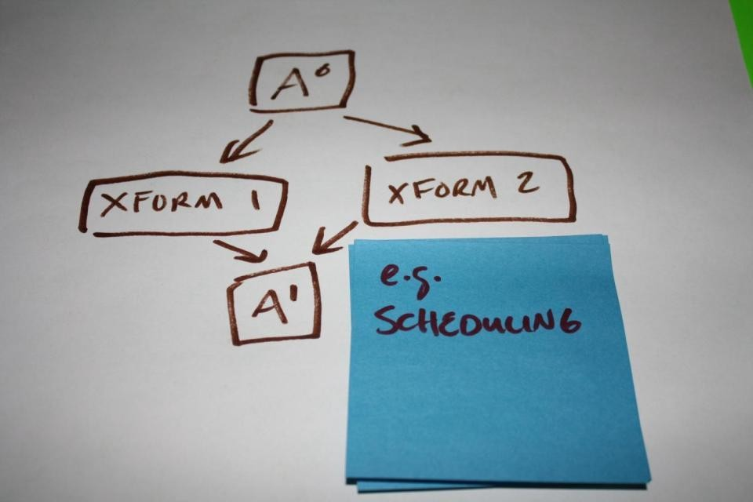

Slide 81
Concurrent
data
would
be
divided
in
to
shared
and
unshared
data
for
xforms.
Doubly-linked list makes no such distinction.
All sequential data structs presume all shared.

Slide 82
Concurrent
data
would
be
divided
by
readers
and
writers
of
data.
Doubly-linked list makes no
such distinction.
All sequential data structs presume anywhere
read/write.

Slide 83
Look
at
any
see
level
of
parallelism to
shared
data
for
transforms.

Slide 84
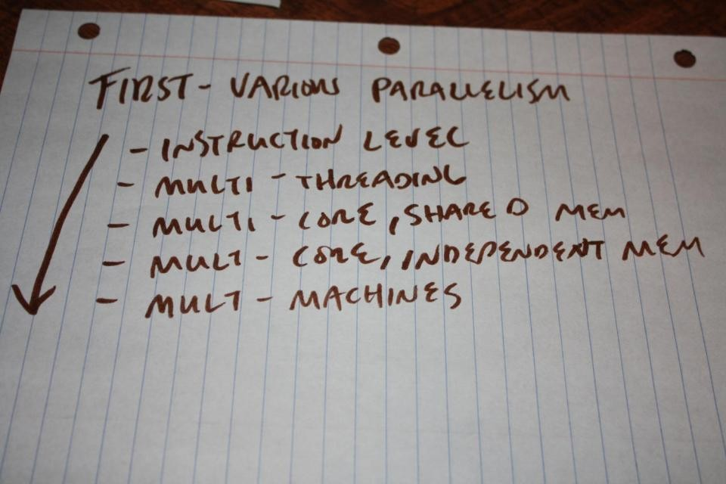

Slide 85


Slide 86
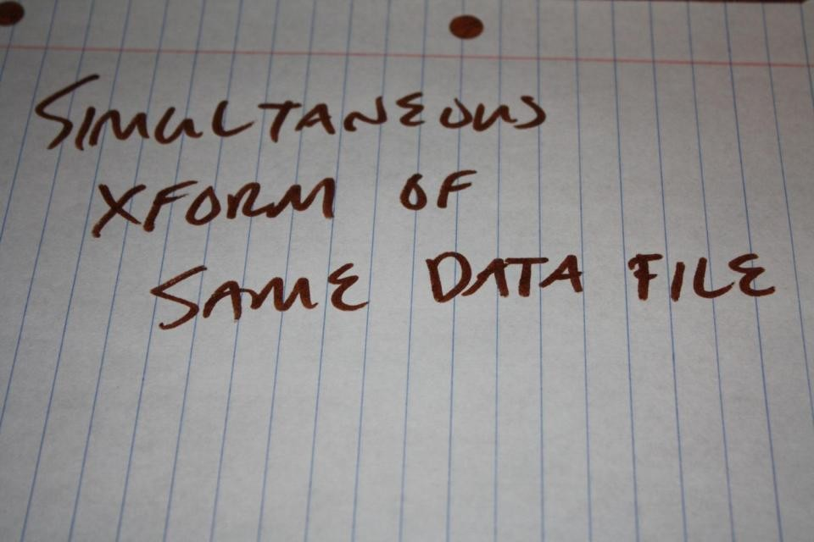

Slide 87
Note:
Data file just generic term for organized data.
e.g.
Registers Cache (lines) Main memory
...or actual file on disk.

Slide 88
Concurrency
wide
is
not
a
system-
property
Doubly-linked list data struct assumes all
operations follow the same (sequential) rules.

Slide 89


Slide 90


Slide 91
Every
concurrent
operation
must
have
explicitly
rules.
defined

Slide 92
Data
is
designed
that
satisfies
all
the
rules.

Slide 93
But
sometimes,
attempts
are
made
to
use
"sequential
rules"
For
example...

Slide 94


Slide 95
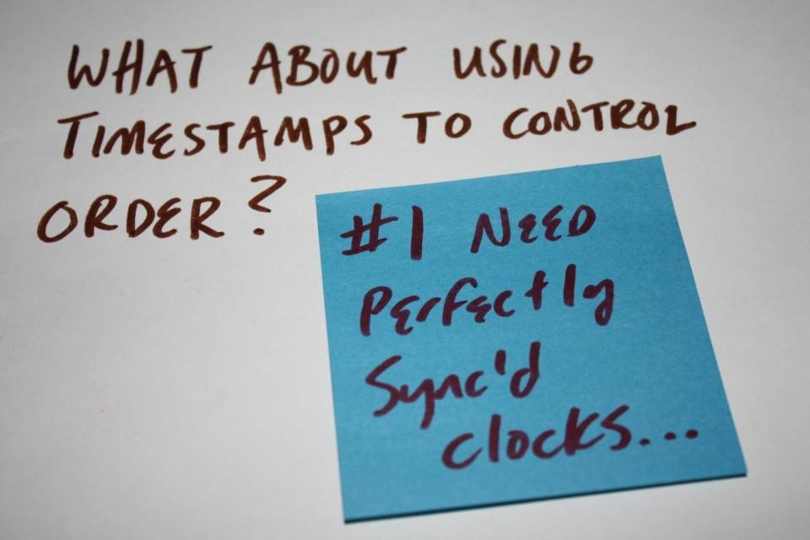

Slide 96
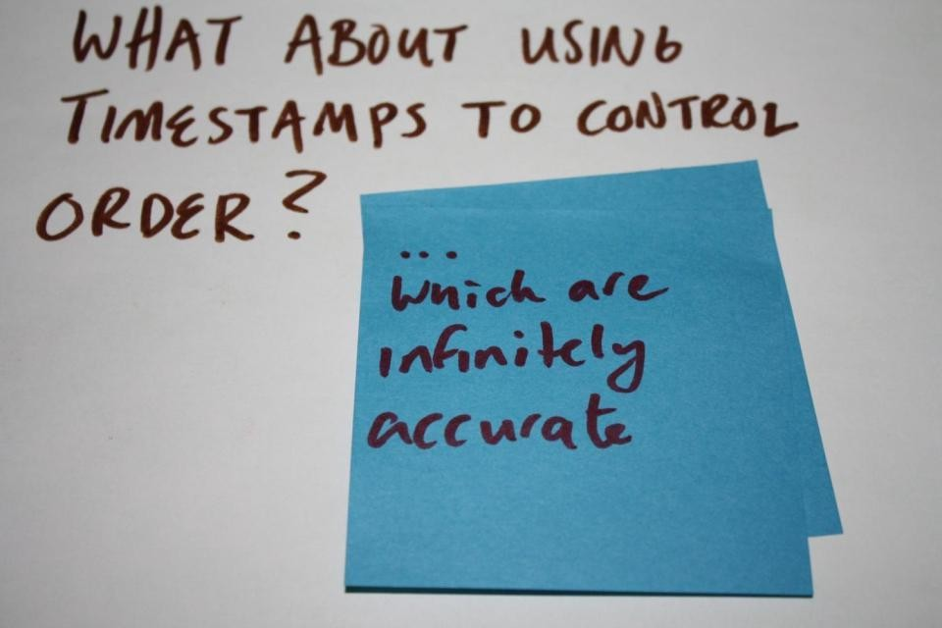

Slide 97
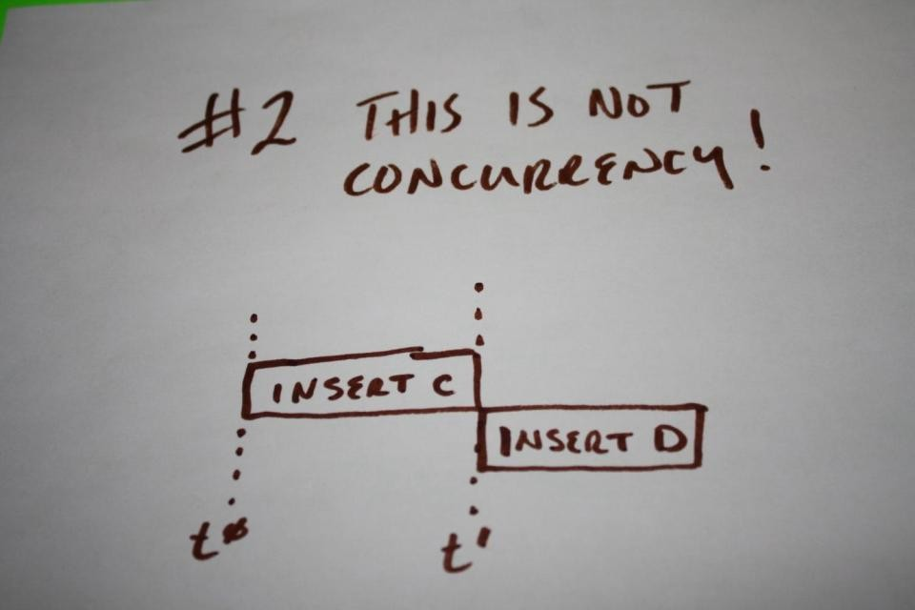

Slide 98


Slide 99


Slide 100


Slide 101


Slide 102


Slide 103


Slide 104
So
sometimes
using
sequential
rules
work.

Slide 105
And
sometimes
it's
the
"right"
thing
to
do.

Slide 106
But
it
must
be
done
in
a
well-
informed
way.
(Know
that's
what
you're
doing!)

Slide 107
What
needs
to
be
solved
per
operation?

Slide 108


Slide 109


Slide 110


Slide 111


Slide 112


Slide 113
But
how do
you
know
what
the
conflicts
are?

Slide 114


Slide 115


Slide 116


Slide 117


Slide 118


Slide 119


Slide 120


Slide 121


Slide 122


Slide 123
i.e.
Understand
the
data!
(It
always
comes
down
to
this)

Slide 124
Defining
insert
an
concurrent
operation:
What
would
it
mean?

Slide 125


Slide 126


Slide 127


Slide 128


Slide 129


Slide 130


Slide 131


Slide 132


Slide 133
How
might
you
answer
these
questions?

Slide 134


Slide 135


Slide 136


Slide 137


Slide 138


Slide 139


Slide 140


Slide 141


Slide 142


Slide 143


Slide 144


Slide 145
But
these
requirements
and
rules
can only
be
defined
in
context

Slide 146


Slide 147


Slide 148


Slide 149


Slide 150


Slide 151


Slide 152


Slide 153


Slide 154


Slide 155


Slide 156
Different
question
answers
to
each
would
change
the
data
structure
required.

Slide 157


Slide 158


Slide 159


Slide 160


Slide 161


Slide 162


Slide 163


Slide 164


Slide 165


Slide 166


Slide 167


Slide 168
Returning to the Question
Which answers/context
does
this
structure
match?
struct
{
Node
Node*
Node* Packet*
next;
prev;
data;
};

Slide 169
Returning to the Question
Which answers/context
does
this
structure
match?
struct
{
Node
Node*
Node* Packet*
next;
prev;
data;
};
NONE. Each set of rules
for concurrent ops and requirements
for latency, etc. would require a completely different struct.

Slide 170
So
how
to define
what
be?
the
data
would

Slide 171


Slide 172
Hardware
is
the
beginning.

Slide 173
Concurrency
problems
can't
be
abstracted
from
how
hardware
works.

Slide 174


Slide 175
i.e.
What
are
the
basic
"primitives"
to
build
concurrency
solutions
with?
Mutexes?
Semaphores?
Mailboxes?
Events?

Slide 176


Slide 177


Slide 178


Slide 179


Slide 180


Slide 181
#1
Practical
Take-Away:
Know
atomic
how
to
do
lock-free
transaction
h/w.
on
your

Slide 182
#1
Practical
Take-Away:
Know
atomic
how
to
do
lock-free
transaction
h/w.
on
your
The fundamental data operation.
Lock-free techniques built on top
of this.

Slide 183


Slide 184


Slide 185


Slide 186


Slide 187


Slide 188


Slide 189


Slide 190


Slide 191
Note
In-order and out-of-order refers to
load/store
unit.
AKA
AKA
weakly-ordered loads/stores
load/store re-ordering
e.g.
SPU
is in-order processor,
but MFC on SPU is not (out of order
DMAs)

Slide 192


Slide 193
Knowing
h/w
allows
adding
minimal
sync
points.
And..

Slide 194


Slide 195


Slide 196


Slide 197
Okay,
So
now
what
needs
to be
defined
BEFORE we
can
even
begin
to
define
the
data?

Slide 198


Slide 199


Slide 200


Slide 201


Slide 202


Slide 203


Slide 204


Slide 205


Slide 206
Do
that
and
you're
on
your
way.
Next set of
talks will apply
these
for
lessons to optimizing data
specific examples.

Slide 207
But
the
"optimized"
part
will
introduce
something
new...
Here's a little teaser...

Slide 208


Slide 209


Slide 210


Slide 211


Slide 212
Thanks!
Great feedback from Bjoern Knafla (@bjoernknafla on twitter).
Plus
he came up with the name for the presentation.
Also
thanks for feedback: @MarcoSalvi, @rickmolloy
Also
thanks Rob Wyatt for feedback - and for suggestions on
even more fun problems and complex cases that we could
cover to make the presentation even longer next time.

